Slide 1

BLOG GENERATION USING FINE TUNED LANGUAGE MODELS
TEAM NAME : INNOVATORS

Slide 2
STATEMENT
The statement focuses on to create a fine tuned model in which the information is given to the system ant it accumulates the raw data and it utilises it for further tasks that to be given

Slide 3
OBJECTIVE
The main objective of the mentioned statement to give information to the database and it utilises that it for final specified tasks
It’s like teaching the child and the child utilises the knowledge in his future endeavours
The datas were collected and stored in a network called neuron network
The detailed information of the above mentioned were explained briefly in the upcoming.

Slide 4
FLOW DIAGRAM
INPUT INFORMATION
INFORMATION GETS STORED
COLLECTED INFORMATION IS USED FOR FURTHER TASKS
NEURON NETWORK

Slide 5
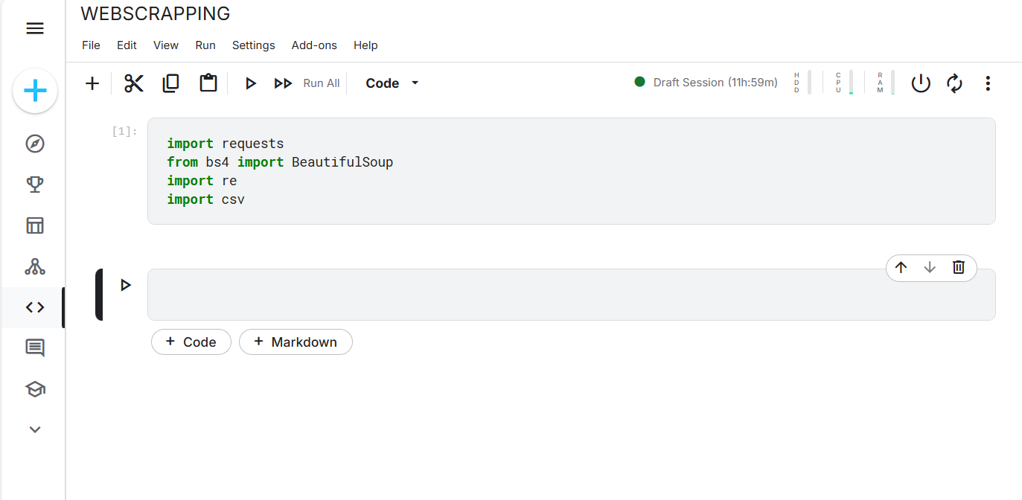
WEB SCRAPPING

Slide 6
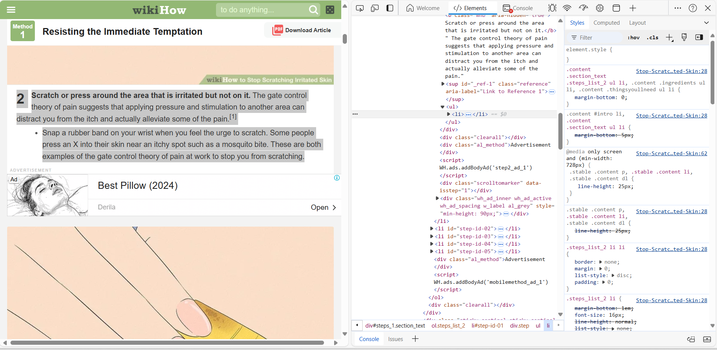

Slide 7
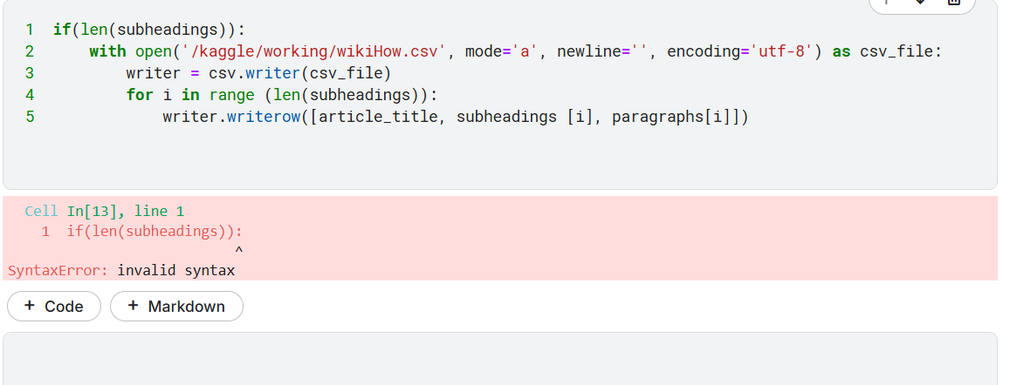

Slide 8
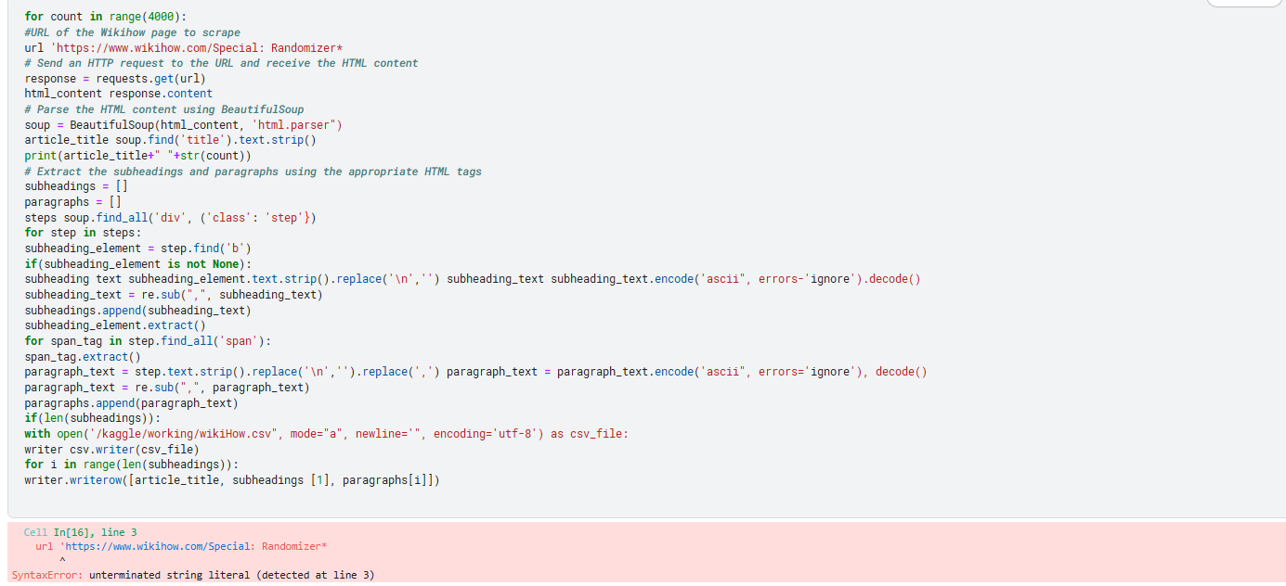

Slide 9
THANK YOU

Slide 10

Thank You
someone@example.com

